Slide 1
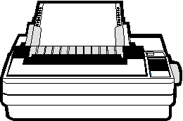
Chapter 10
Printing and Spooling
Transfering your work to paper !

Slide 2
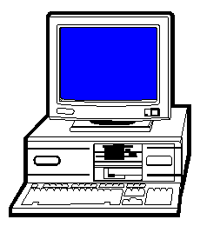
Your typical printer setup, one PC and a printer.

Slide 3
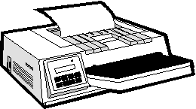
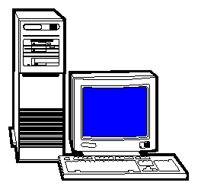
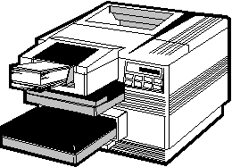
Typical Unix system. One server and multiple printers.

Slide 4
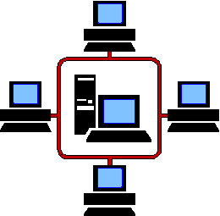
It’s not unusual to have a printer attached via the network as
well a directly connected to the Unix server.

Slide 5
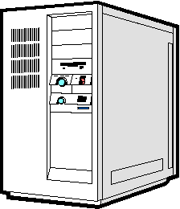

Slide 6
Printer destinations and printer queues
A printer may be referred to by its name
or the class that it belongs to. A class may
have one or more printers assigned to it.
Each printer and printer class has its own
print queue where the print jobs are stored.

Slide 7
Draft
printer A
Admin Class
printer B
Legal

